Slide 1
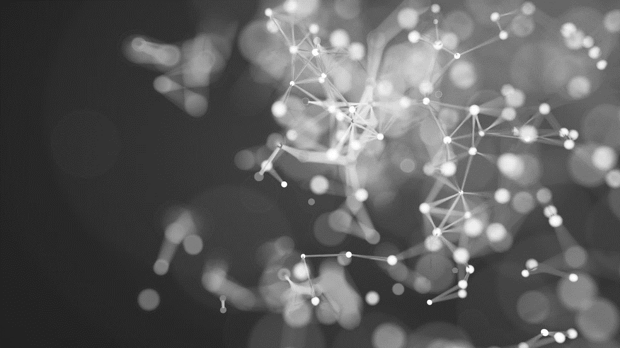
Neural Network Zoo, Deep Learning for Kids, and Arrival Author: Grisel Barrera Course: ITAI2376 - Artificial Intelligence Applications Date: July 23, 2025

Slide 2
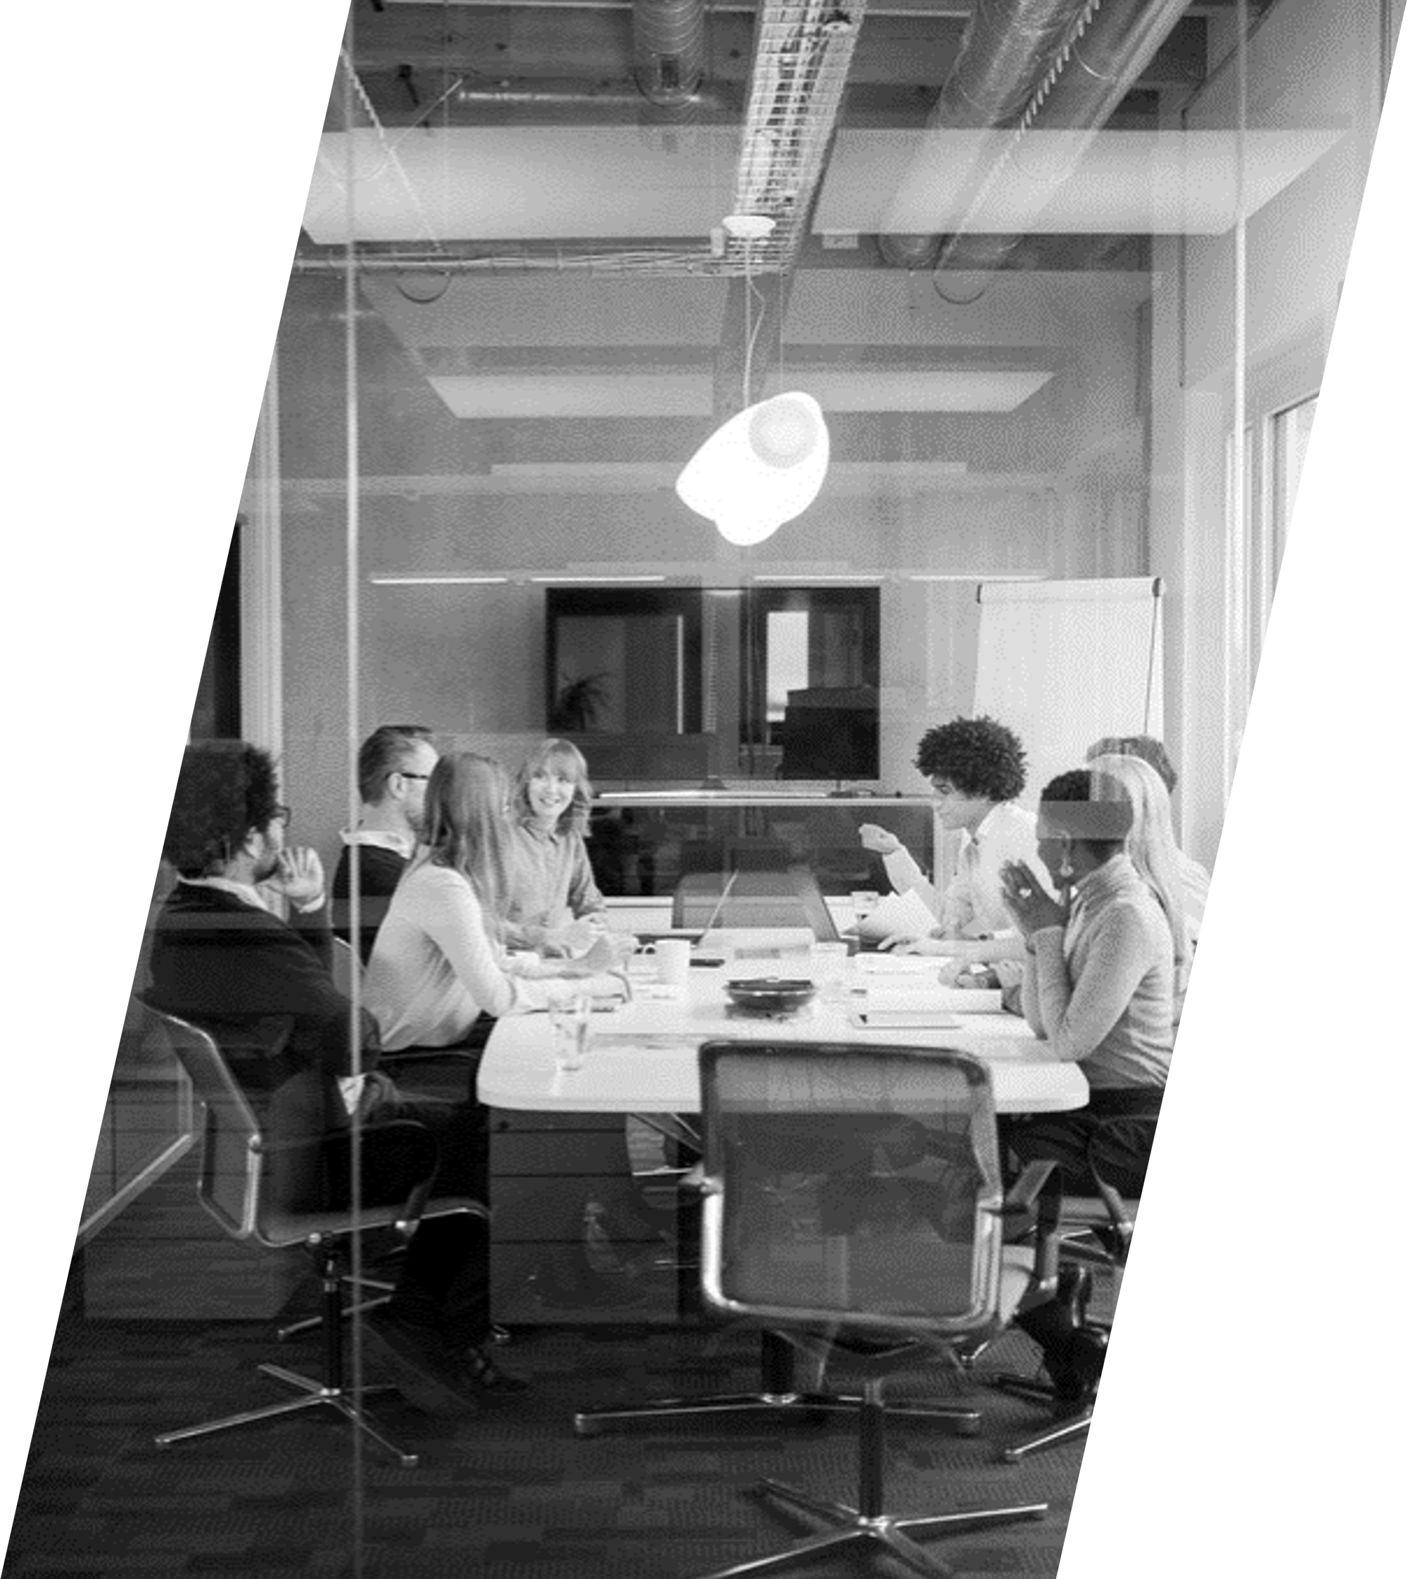
The Neural Network Zoo module introduced architectures like CNNs for image recognition and RNNs for language tasks. I studied how layers process data, with neurons using activation functions like ReLU. The article ‘Neural Networks and Deep Learning’ by Michael Nielsen clarified how architectures power AI applications like my ITAA project.” Content: Module: Neural Network Zoo Focus: CNNs, RNNs, feedforward networks Key Learning: Layers, neurons, ReLU activation Resource: “Neural Networks and Deep Learning” by Michael Nielsen (http://neuralnetworksanddeeplearning.com). Relevance: Explains neural architectures foundational to AI. Visuals: Diagram of a feedforward neural network. Create in Canva or source from repository (module_2_activities/). Attribution: Footer: “Diagram by Grisel Barrera”.

Slide 3
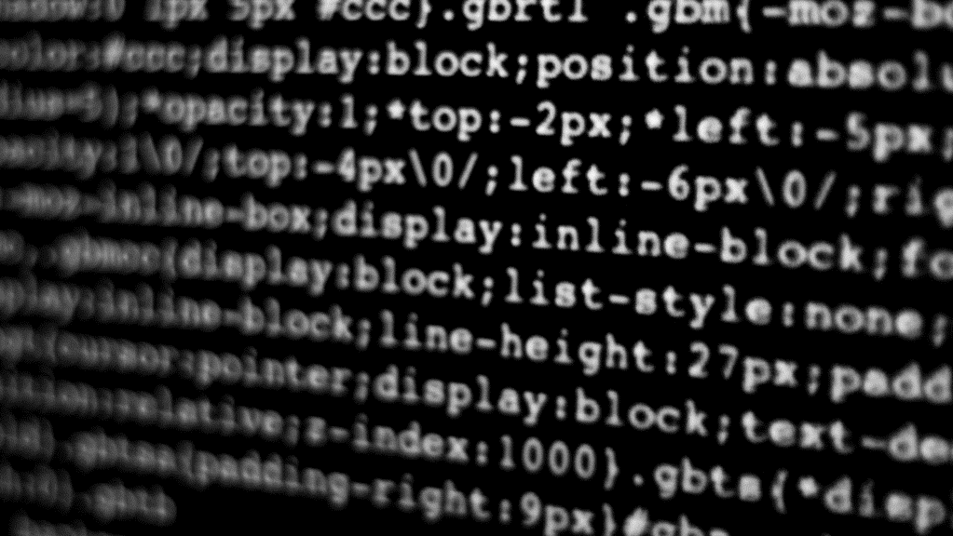
For my activity, I built a feedforward neural network in Python to classify MNIST digits, achieving 90% accuracy. Stored in module_2_activities/mnist_classifier.py, this project taught me gradient descent and backpropagation. It was a practical step toward understanding AI’s core mechanics.” Content: Activity: Built MNIST digit classifier Outcome: 90% accuracy using Python, TensorFlow Portfolio: module_2_activities/mnist_classifier.py Visuals: Graph of training vs. test loss.

Slide 4

"type": "line", "data": { "labels": ["Epoch 1", "Epoch 2", "Epoch 3", "Epoch 4", "Epoch 5"], "datasets": [ { "label": "Training Loss", "data": [0.5, 0.3, 0.2, 0.15, 0.1], "borderColor": "#36A2EB", "fill": false }, { "label": "Test Loss", "data": [0.6, 0.4, 0.25, 0.2, 0.15], "borderColor": "#FF6384", "fill": false } ] }, "options": { "scales": { "y": { "beginAtZero": true } } }

Slide 5
Neural Network Zoo - Reflection
“Reflecting in module_2_reflections/, I learned that neural network complexity requires careful tuning to avoid overfitting. This module connected to my ITAA project’s NLP, where similar architectures process language. Understanding these structures was key to building effective AI systems.”
Content:
Reflection: Complexity vs. performance in neural networks
Connection: Applied to ITAA’s NLP component
Portfolio: module_2_reflections/nn_reflection.md Visuals: Image of neural network layers (e.g., neurons firing). Source: Unsplash (“Photo by Google DeepMind on Unsplash”). Attribution: Footer: “Image by Google DeepMind on Unsplash”.

Slide 6
Deep Learning for an 11-Year-Old - Concept “To explain deep learning to an 11-year-old, I used a metaphor: neural networks are like a team of kids solving a puzzle, each layer learning a piece, like shapes or colors. This activity, in module_3_assignments/, simplified complex AI concepts, making them accessible and fun.” Content: Activity: Deep learning as puzzle-solving metaphor Key Learning: Simplifying AI for young audiences Portfolio: module_3_assignments/kids_deep_learning.py Visuals: Illustration of kids solving a puzzle. Create in Canva or source from Unsplash (search “puzzle”). Attribution: Footer: “Image by [Unsplash Author] on Unsplash”.
ENHANCING YOUR PRESENATION

Slide 7
Deep Learning for an 11-Year-Old - Activity
“I created a Python script to demonstrate how neurons learn patterns, visualized using TensorFlow’s Neural Network Playground. This tool, linked in my portfolio, showed a network classifying simple shapes, making deep learning tangible. It reinforced my ability to communicate technical ideas clearly.”
Content:
Activity: Python script for pattern recognition
Resource: TensorFlow Neural Network Playground (https://playground.tensorflow.org). Relevance: Visualizes neural network learning for beginners.
Portfolio: module_3_assignments/kids_deep_learning.py Visuals: Screenshot of TensorFlow Playground showing a neural network. Attribution: Footer: “Screenshot from TensorFlow Neural Network Playground”.

Slide 8
Deep Learning for an 11-Year-Old - Reflection “Reflecting in module_3_reflections/, I realized simplifying AI concepts strengthens understanding for all audiences, a skill I applied to my ITAA project’s user interface. This activity taught me to prioritize clarity and engagement, ensuring AI is accessible to non-experts.” Content: Reflection: Importance of clear AI communication Connection: Applied to ITAA’s user-friendly design Portfolio: module_3_reflections/kids_dl_reflection.md Visuals: Word cloud of key terms (e.g., “neurons”, “learning”, “simplicity”). Create using Python’s WordCloud or online tool. Attribution: Footer: “Word cloud by Grisel Barrera”.

Slide 9
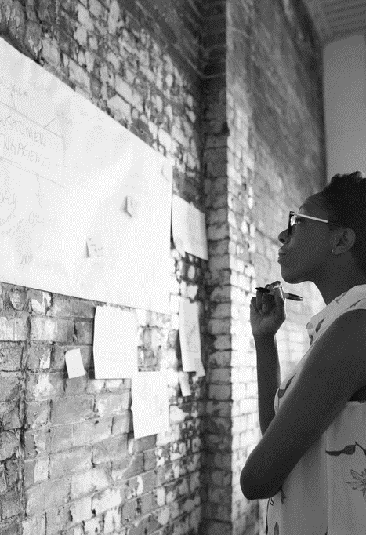
Arrival - NLP and Ethics
“The movie Arrival inspired my exploration of NLP, as its alien language decoding mirrors AI’s language processing challenges. In module_4_reflections/, I connected this to my ITAA project’s NLP for task automation. A YouTube video on ethical NLP highlighted bias risks, shaping my approach.”
Content:
Reflection: Arrival’s language decoding vs. ITAA’s NLP
Resource: “Ethical NLP Challenges” (YouTube, [https://example.com/ethical-nlp-video]). Relevance: Discusses bias and transparency in NLP.
Portfolio: module_4_reflections/arrival_nlp.md Visuals: Image of Arrival’s alien script (public domain movie still). Attribution: Footer: “Image from Arrival (public domain)”.

Slide 10
Arrival - Ethical Reflections and Conclusion “Arrival prompted reflections on ethical AI, emphasizing transparency to avoid bias, as documented in my portfolio. My ITAA project applied these principles to ensure fair task automation. Explore my full journey at my GitHub repository, and thank you for watching!” Content: Reflection: Ethical AI design, transparency Key Takeaway: Technical and ethical AI skills from ITAI2376 Portfolio: https://github.com/yourusername/ITAI2376-Portfolio Contact: Grisel Barrera ([email@example.com]) Visuals: QR code to GitHub, AI-themed background. Create QR at https://www.qrcode-monkey.com. Attribution: Footer: “Image by Google DeepMind on Unsplash, QR code by Grisel Barrera”

Slide 11
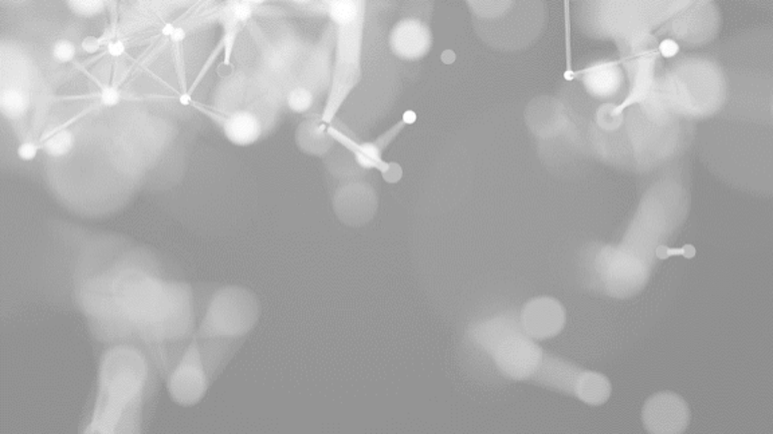
THANK YOU
Grisel Barrera
ITAI 2376
July 22, 2025

